Slide 1
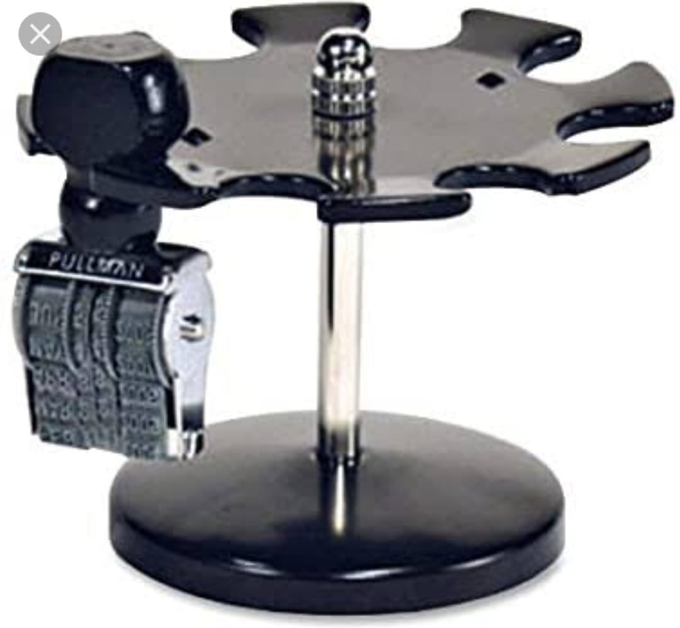
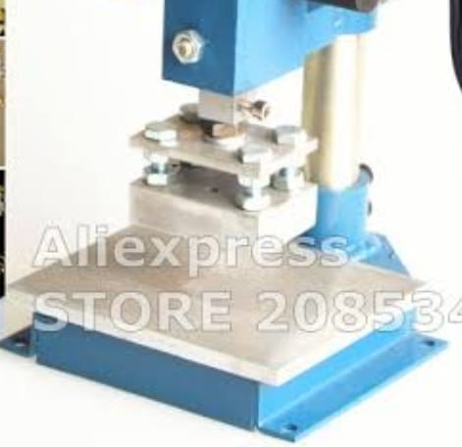
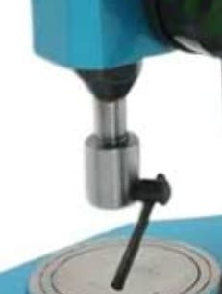
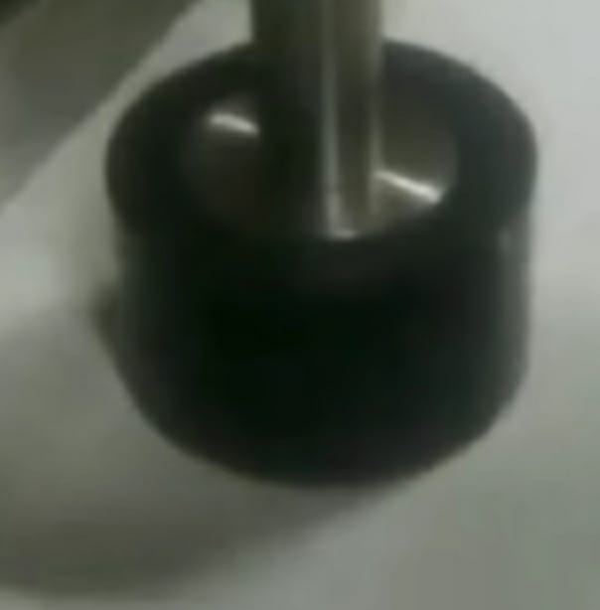
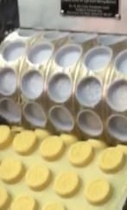
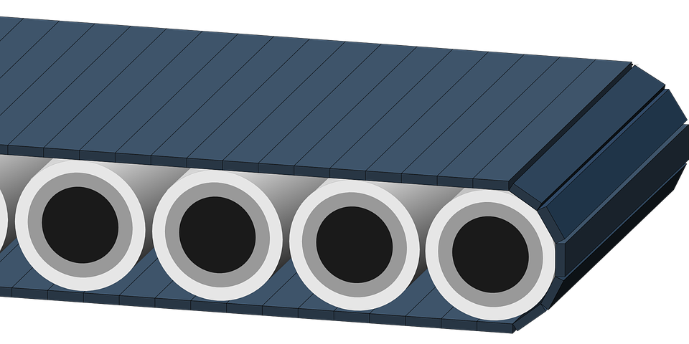
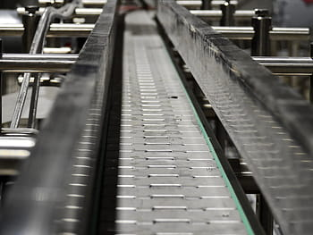
 | MEANS.01 | MEANS.02 | MEANS.03 | MEANS.04
HOLD DESIGN
STAMP DESIGN |  |  | HYDRAULIC STAMPING
FORWARD SWEET | CONVEYER BELT | TRACK SYSTEM | SLED | RAKE
COLLECT SWEET | BOX | COVER | TRAY | PACKET
DETECT SWEET | IR SENSOR | ULTRASONIC SENSOR
INDICATION | ALARM | LIGHT | HORN

